Slide 1
Skin Cancer Diagnosis
Ankita Gondkar
Bana 6390 Fall 2023

Slide 2
Objective
Develop a cloud-based skin cancer detection system using the HAM10000 dataset that can accurately distinguish between Traditional Machine Learning (ML) and Automated Machine Learning (AutoML) models for classifying skin lesions. Google Cloud Platform (GCP) will be utilized for data ingestion, preprocessing, and model training to achieve accurate and interpretable insights into different skin cancer detection.

Slide 3
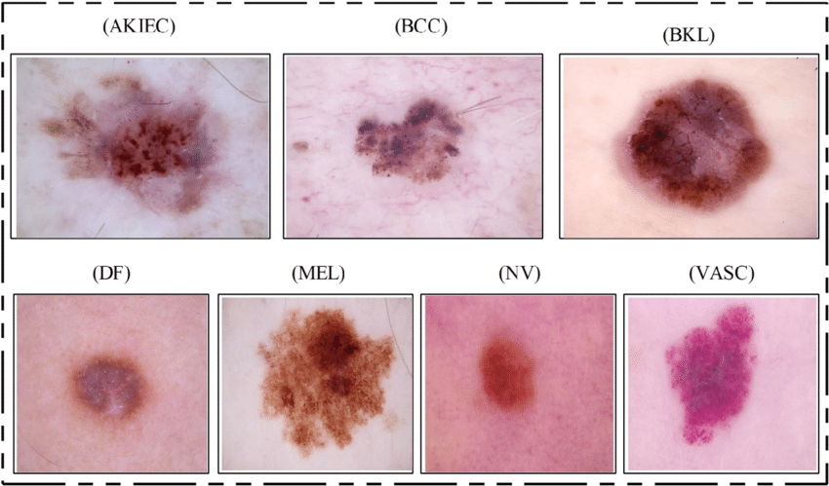
Dataset Characteristics
Data Source: HAM10000 Dataverse
Number of Images: 10,015 dermatoscopic images

Slide 4
Tools & Techniques
Flow
Data Ingestion
Data Preparation
Model Training
Model Evaluation
Jupyter Notebook
Pandas
Scikit-learn
TensorFlow
Matplotlib
Vertex AI
AutoML

Slide 5
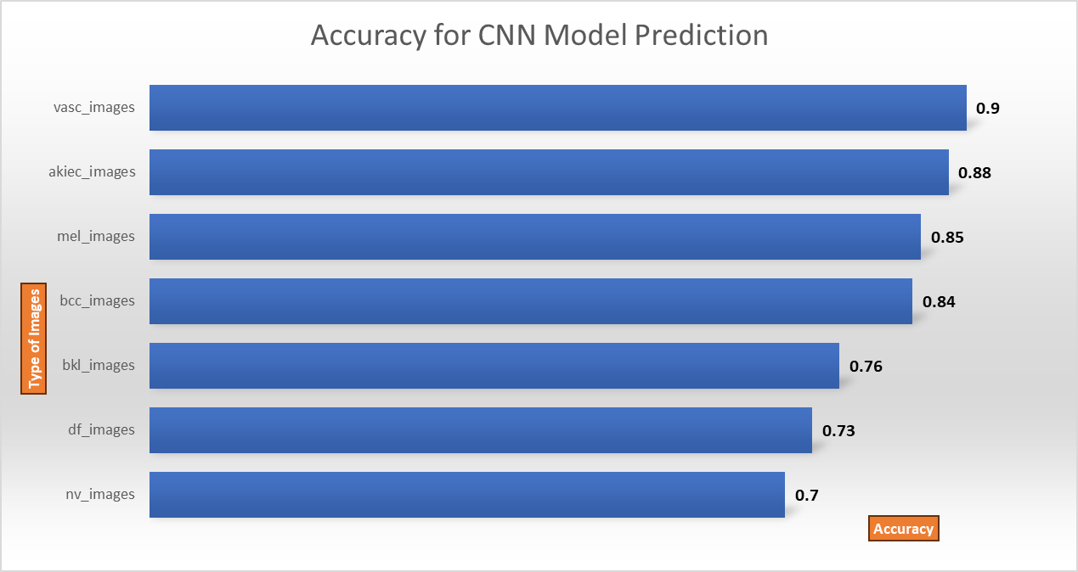
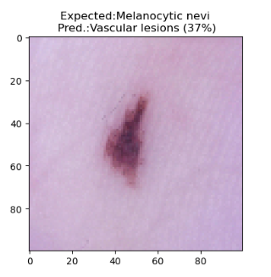
Melanocytic nevi have a 37% probability of being misclassified as vascular lesions by a machine learning model

Slide 6
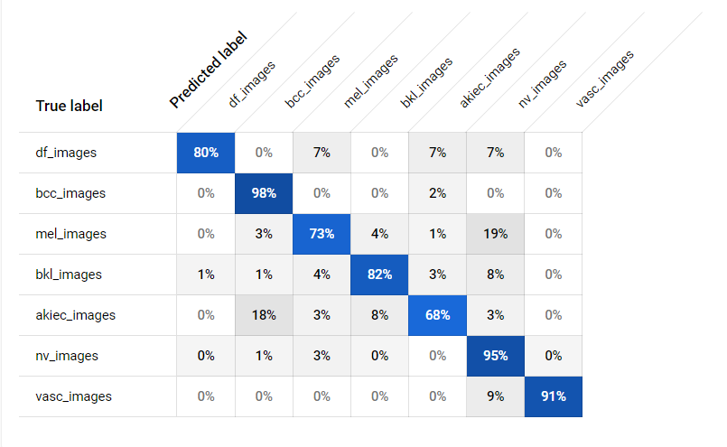
Vascular lesions have distinct characteristics that both models can effectively identify

Slide 7
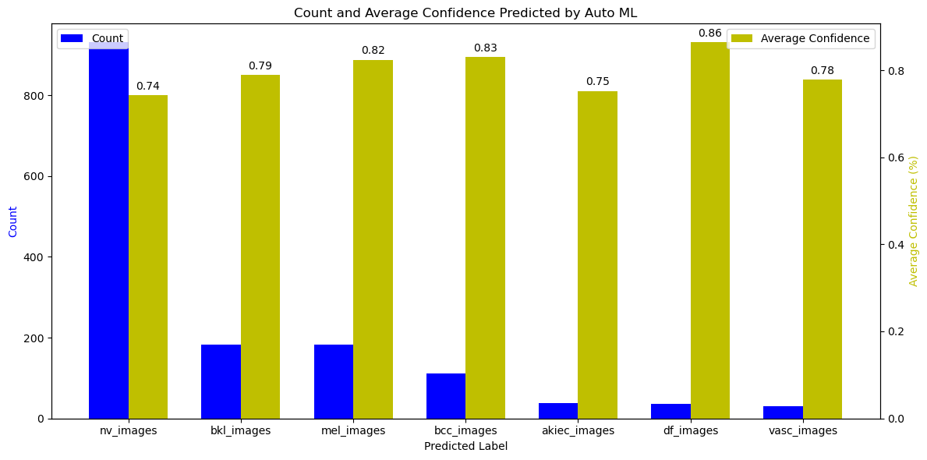
Auto ML test predictions do not depend on the count of images you provide

Slide 8
AutoML is more efficient for predicting BCC, MEL and BKL skin cancer type

Slide 9
Conclusion
Machine learning models can be effective at detecting vascular lesions, but they are not perfect
Vascular lesions exhibit unique and easily recognizable visual features, making them distinguishable by different modeling approaches
AutoML can deliver consistent results regardless of the dataset size, which is valuable for scalability and ease of use
AutoML is a viable option for Basal Cell Carcinoma (BCC), Melanoma (MEL), and Benign Keratosis-Like Lesions (BKL) skin cancer types, potentially saving time and effort in model development compared to traditional methods.

Slide 10
THANK YOU

